Slide 1
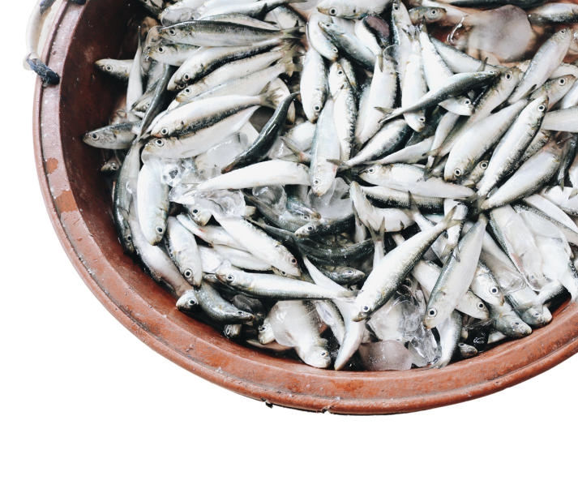
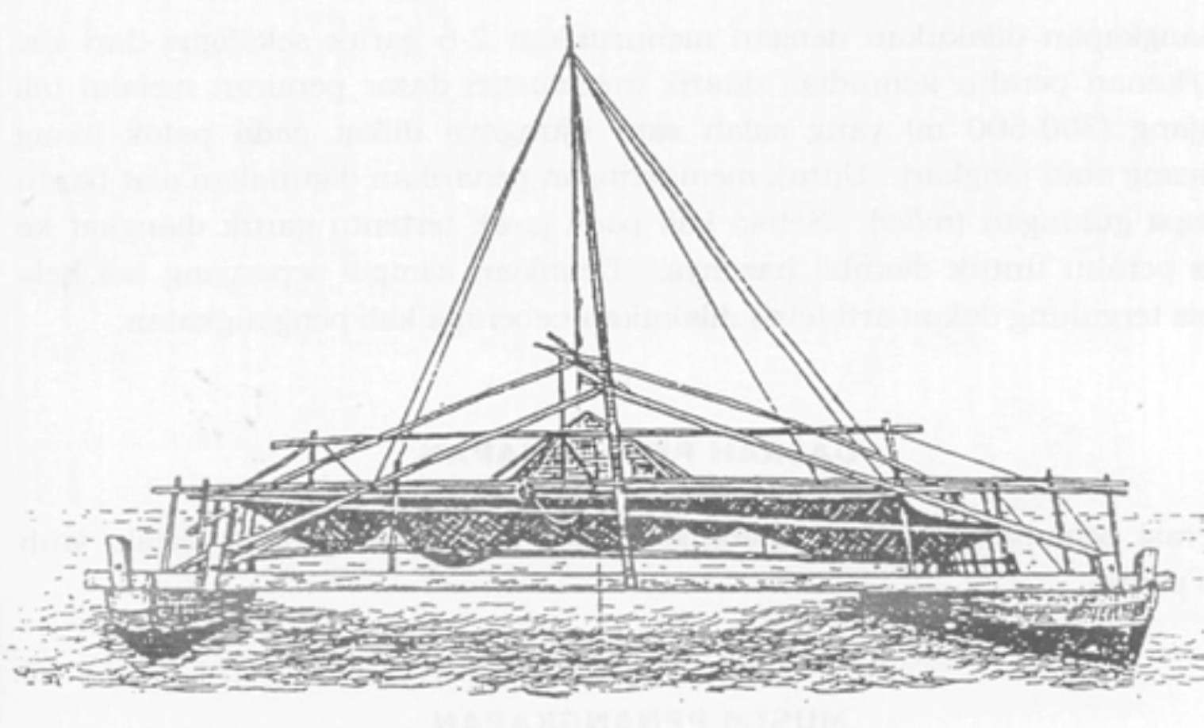




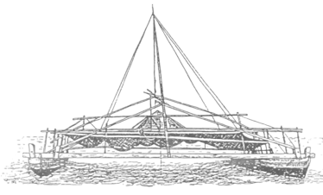
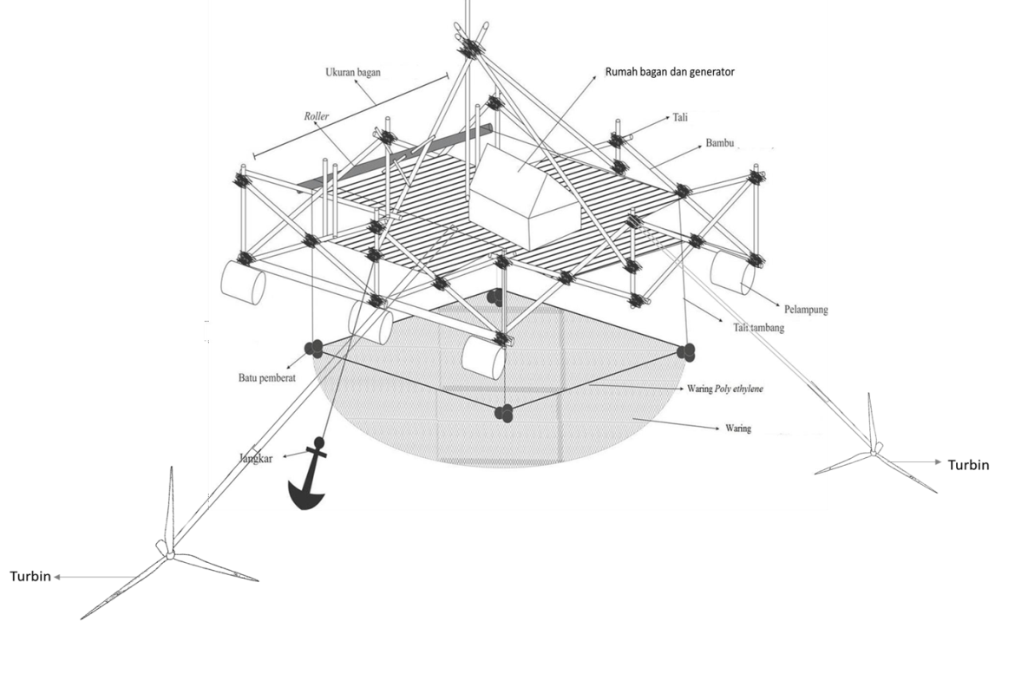
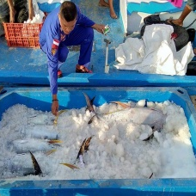
Design and Build a Cooling Box Feat Bagan Underwater Turbine System: Optimization of Ocean Current Energy as a Renewable Energy Source in the Storage of Gili Labak Sumenep Fishermen's Fish Catches (Study of System Design and Mapping of Current Potential against Resulting Electric Power
INTRODUCTION
METHODS
RESULTS
Floating Bagan
The power plant is designed with a simple mechanism through modification of the pagan house or the added floating bagan
The determination of the placement of the turbine depth with the highest potential is in :
Depth : 4 meter - Minimum speed : 0.007 m/s
Max speed: 0.783 m/s - Average speed : 0.2405 m/s
Where to catch fish
Where to house fish
Layover places
with turbines & electric generators
Propeller turbines have the highest yield compared to other yields with an average of 18.91339 watts. While the turbine has a low value with an average of 1.467161 watts on the gorlov LC 500 turbine.
Ice Blocks
cooling using ice blocks can only maintain the temperature low in a short period of time and will increase the load of the boatload.
CONCLUSION
The producer of sources of electrical energy using ocean currents is also determined by the type of turbine and the placement of the turbine depth. In addition, turbine innovations on floating charts can be relied upon for the construction of electricity using ocean current energy.
OBJECTIVES
Providing solutions for the availability of electricity in the Gili Labak area, Sumenep, and offering a renewable source of electrical energy, namely ocean currents.
Improving the quality and quantity of fish caught by fishermen by using cooling boxes
REFERENCES
ACKNOWLEDGEMENT

